Slide 1
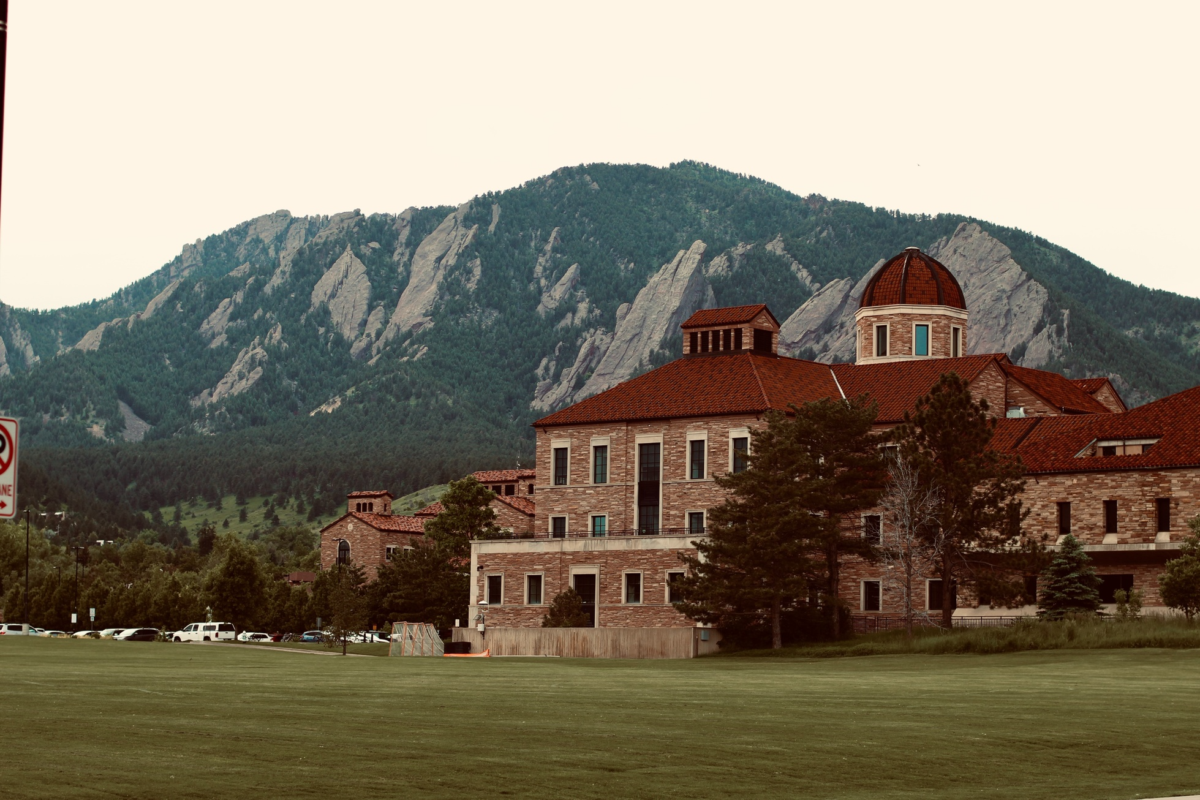
WeatherTech WorkForce Scheduling
Presented By:
Sai Arvind Atluri
Amandeep Bhardwaj
Himani Porwal
Introduction to workforce scheduling optimization at WeatherTech cafes

Slide 2

Introduction to Workforce Scheduling at WeatherTech
Scheduling Dynamics: Emphasizes the complexity of scheduling in a setting with variable demands and a mix of full-time and part-time staff.
Operational Constraints: How introducing the various constraints that affect scheduling, from budget limitations to employee availability.
Project Focus: Analysis of Weathertech workforce scheduling (Fall/ Spring)
Importance: Underscoring the significance of effective scheduling in maintaining operational efficiency and meeting organizational goals.

Slide 3

PROBLEM STATEMENT
Operation: Open 7 days a week with varying daily demands.
Staff: Mix of full-time and part-time employees.
Requirements: At least one full-time employee for closing.
Full-time: Minimum 40 hours/week.
Part-time (students): Flexible shifts based on class schedules. Minimum 10 hours/week and Maximum 20 hours/week
Hourly Pay:
Full-time: $20/hour.
Part-time: $16/hour.
Budget Constraint: Choices between reducing hours or staff layoffs. Summer
Operations: Only full-time staff due to student absence.
Solution: Use linear programming and Gurobi for workforce optimization. Applicability: Extendable to other university shift-based employment scenarios.

Slide 4


Solution
Linear Programming Formulation
Gurobi Optimization Software
WorkForce Scheduling Challenges
Cost Savings

Slide 5

LP FORMULATION

Slide 6
DECISION VARIABLES
Full-Time Employees’ Work Schedule
Variable: Xft,i,d,s
​Description: Binary variable (1 or 0).
Meaning:
1: Full-time employee i works on day d during shift s.
0: Employee does not work.

Slide 7
DECISION VARIABLES
Part-Time Students’ Work Schedule
Variable: Xpt,j,d,s
Description: Binary variable (1 or 0).
Meaning:
1: Part-time student j works on day d during shift s.
0: Student does not work.

Slide 8
OBJECTIVE FUNCTION
Our objective is to minimize costs by calculating the total wages for full-time and part-time staff. This involves multiplying the number of shifts each employee works by their respective hourly wage and shift length. Through this method, we aim to achieve a cost-effective balance between our budget constraints and staffing needs.
Minimize Total Cost:
Sum(Xft,i,d,s * fulltime_hourlywage * ShiftLength) +
Sum(​Xpt,j,d,s * parttime_hourlywage * ShiftLength)

Slide 9
CONSTRAINTS
1. Staffing Requirements for Each Shift (Fall/Spring):
For each shift during the fall and spring seasons, we ensure staffing requirements are met by having at least the required number of full-time and part-time workers.
Sum (Xft,i,d,s) ≥ FT_requirement[d,s],
Sum (Xpt,j,d,s) ≥ PT_requirement[d,s]

Slide 10
CONSTRAINTS
2. Working Hours Constraint for Part-Time Students:
We maintain a balance in part-time staffing, ensuring that the total hours worked by part-time employees each day are between 10 and 20 hours.
Sum(Xpt,j,d,s * ShiftLength) ≥ 10
Sum(Xpt,j,d,s * ShiftLength) ≤ 20

Slide 11
CONSTRAINTS
3. Working Hours Constraint for Full-Time Employees:
We ensure full-time employees work a minimum of 40 hours per week
Sum(Xft,i,d,s * ShiftLength) ≥ 40

Slide 12
CONSTRAINTS
4. Day Off for Full-Time Employees:
The total number of days full-time employees work each week is limited to one less than the total number of working days.
Sum(Xft,i,d) ≤ Number of Working Days per Week−1

Slide 13

GUROBI MODEL

Slide 14
DATA
# Constants
FT_EMPLOYEES = 4 # Number of full-time employees
FT_HOURLY_WAGE = 20
FT_SHIFT_LENGTH = 8 # Full-time shift length in hours
PT_EMPLOYEES = 19 # Number of part-time employees
PT_HOURLY_WAGE = 16
PT_SHIFT_LENGTH = 4 # Part-time shift length in hours
DAYS = ["Mon", "Tue", "Wed", "Thu", "Fri", "Sat", "Sun"]
FT_SHIFT_TIMES = ["Morning", "Evening"] # Morning: 7am-3pm, Evening: 3pm-11pm

Slide 15
DATA
# Part-time shift times: each shift is 4 hours
PT_SHIFT_TIMES = ["7am-11am", "9am-1pm", "11am-3pm", "1pm-5pm", "3pm-7pm",
"5pm-9pm", "7pm-11pm", "9pm-11pm"]
PT_SHIFT_PERIODS = ["7am-9am", "9am-11am", "11am-1pm", "1pm-3pm",
"3pm-5pm", "5pm-7pm", "7pm-9pm", "9pm-11pm"]
# Define shift periods to manage overlapping shifts
shift_periods = {
"7am-11am": ["7am-9am", "9am-11am"], "9am-1pm": ["9am-11am", "11am-1pm"],
"11am-3pm": ["11am-1pm", "1pm-3pm"],"1pm-5pm": ["1pm-3pm", "3pm-5pm"],
"3pm-7pm": ["3pm-5pm", "5pm-7pm"], "5pm-9pm": ["5pm-7pm", "7pm-9pm"],
"7pm-11pm": ["7pm-9pm", "9pm-11pm"], "9pm-11pm": ["9pm-11pm"]
}

Slide 16
DATA
# Staffing requirements for full-time employees
FT_REQ_FALL_SPRING = {"Mon": {"Morning": 2, "Evening": 2},
"Tue": {"Morning": 2, "Evening": 2},
"Wed": {"Morning": 2, "Evening": 2},
"Thu": {"Morning": 2, "Evening": 2},
"Fri": {"Morning": 1, "Evening": 1},
"Sat": {"Morning": 1, "Evening": 1},
"Sun": {"Morning": 1, "Evening": 1}}

Slide 17
DATA
# Staffing requirements for part-time employees for each 2-hour block
PT_REQ_FALL_SPRING_NEW = {
"Mon": {"7am-9am": 3, "9am-11am": 3, "11am-1pm": 3, "1pm-3pm": 3,
"3pm-5pm": 3, "5pm-7pm": 3, "7pm-9pm": 3, "9pm-11pm": 3},
"Tue": {"7am-9am": 3, "9am-11am": 3, "11am-1pm": 3, "1pm-3pm": 3,
"3pm-5pm": 3, "5pm-7pm": 3, "7pm-9pm": 3, "9pm-11pm": 3},
"Wed": {"7am-9am": 3, "9am-11am": 3, "11am-1pm": 3, "1pm-3pm": 3,
"3pm-5pm": 3, "5pm-7pm": 3, "7pm-9pm": 3, "9pm-11pm": 3},
"Thu": {"7am-9am": 3, "9am-11am": 3, "11am-1pm": 3, "1pm-3pm": 3,
"3pm-5pm": 3, "5pm-7pm": 3, "7pm-9pm": 3, "9pm-11pm": 3},
"Fri": {"7am-9am": 3, "9am-11am": 3, "11am-1pm": 3, "1pm-3pm": 3,
"3pm-5pm": 3, "5pm-7pm": 3, "7pm-9pm": 3, "9pm-11pm": 3},
"Sat": {"7am-9am": 4, "9am-11am": 4, "11am-1pm": 4, "1pm-3pm": 4,
"3pm-5pm": 4, "5pm-7pm": 4, "7pm-9pm": 4, "9pm-11pm": 4},
"Sun": {"7am-9am": 4, "9am-11am": 4, "11am-1pm": 4, "1pm-3pm": 4,
"3pm-5pm": 4, "5pm-7pm": 4, "7pm-9pm": 4, "9pm-11pm": 4}
}

Slide 18
Decision Variables
# Initialize the model
model = gp.Model("Workforce_Scheduling")
# Decision Variables for full-time employees
work_ft = model.addVars(FT_EMPLOYEES, DAYS, FT_SHIFT_TIMES, vtype=GRB.BINARY, name="work_ft")
# Decision Variables for part-time employees
work_pt = model.addVars(PT_EMPLOYEES, DAYS, PT_SHIFT_TIMES, vtype=GRB.BINARY, name="work_pt")

Slide 19
Objective function
# Objective Function: Minimize total wage costs
total_wages_ft = sum(work_ft[i, day, shift] * FT_HOURLY_WAGE *FT_SHIFT_LENGTH
for i in range(FT_EMPLOYEES)
for day in DAYS
for shift in FT_SHIFT_TIMES)
total_wages_pt = sum(work_pt[j, day, shift] * PT_HOURLY_WAGE * PT_SHIFT_LENGTH
for j in range(PT_EMPLOYEES)
for day in DAYS
for shift in PT_SHIFT_TIMES)
model.setObjective(total_wages_ft + total_wages_pt, GRB.MINIMIZE)

Slide 20
Constraints
# Full-time staffing requirements
for day in DAYS:
for shift in FT_SHIFT_TIMES:
model.addConstr(sum(work_ft[i, day, shift] for i in range(FT_EMPLOYEES)) == FT_REQ_FALL_SPRING[day][shift], f"ft_req_{day}_{shift}")
# Part-time staffing requirements for every 4-hour block
for day in DAYS:
for period in PT_SHIFT_PERIODS:
model.addConstr(
sum(work_pt[j, day, shift]
for j in range(PT_EMPLOYEES)
for shift in PT_SHIFT_TIMES
if period in shift_periods[shift]
)
>= PT_REQ_FALL_SPRING_NEW[day][period],
f"pt_coverage_{day}_{shift}"
)

Slide 21
Constraints
# Prevent overlapping shifts for part-time employees using shift periods
for j in range(PT_EMPLOYEES):
for day in DAYS:
for period in PT_SHIFT_PERIODS:
model.addConstr(
sum(work_pt[j, day, shift]
for shift in PT_SHIFT_TIMES
if period in shift_periods[shift]
)
<=
1,
f"no_overlap_pt_{j}_{day}_{period}"
)

Slide 22
Constraints
# Full-time employee minimum hours constraint
for i in range(FT_EMPLOYEES):
model.addConstr(sum(work_ft[i, day, shift] for day in DAYS for shift in FT_SHIFT_TIMES) * FT_SHIFT_LENGTH >= 40,
f"ft_min_hours_{i}")
# Part-time employee maximum hours constraint
for j in range(PT_EMPLOYEES):
model.addConstr(sum(work_pt[j, day, shift] for day in DAYS for shift in PT_SHIFT_TIMES) * PT_SHIFT_LENGTH <= 20,
f"pt_max_hours_{j}")

Slide 23
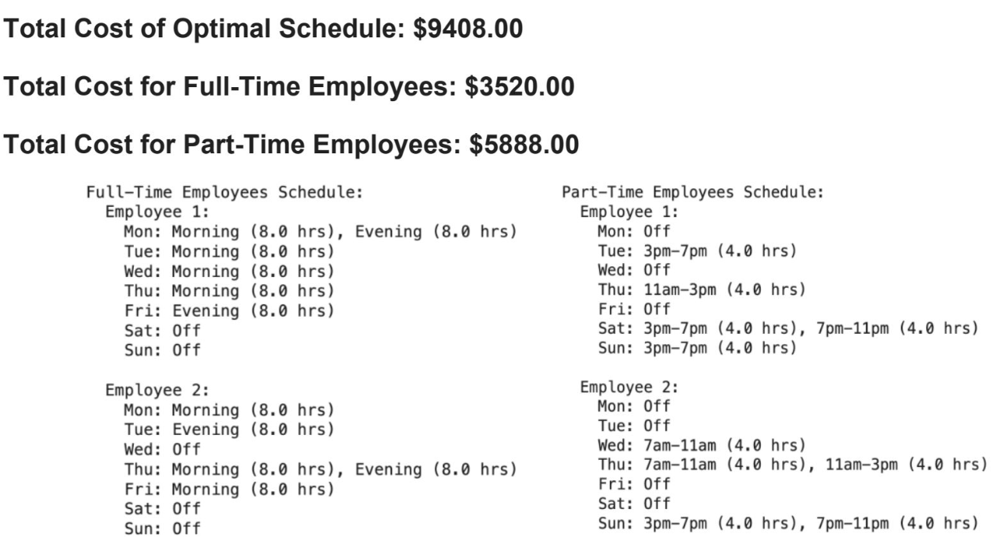
Output
# Full-time employee minimum hours constraint
for i in range(FT_EMPLOYEES):
model.addConstr(sum(work_ft[i, day, shift] for day in DAYS for shift in FT_SHIFT_TIMES) * FT_SHIFT_LENGTH >= 40,
f"ft_min_hours_{i}")
# Part-time employee maximum hours constraint
for j in range(PT_EMPLOYEES):
model.addConstr(sum(work_pt[j, day, shift] for day in DAYS for shift in PT_SHIFT_TIMES) * PT_SHIFT_LENGTH <= 20,
f"pt_max_hours_{j}")

Slide 24




WorkForce Scheduling Challenges
Solution Approach
Resolution
Initial Challenge
Utilized Gurobi's model.computeIIS() to generate an ILP file, enabling detailed analysis of part-time constraints
Corrected the model with manual recalculations and guidance from the professor, ensuring compliance with daily and weekly work hour limits
Scheduling part-time employees without overlap; 4-hour shifts from 7 AM to 7 PM; additional staff required on weekends
Infeasibility Issue
Outcome
Key Discovery
Initial model led to infeasible solutions, particularly for weekend staffing
Successfully implemented a feasible and efficient scheduling system for part-time employees.
Model allowed part-timers to work over 20 hours/day

Slide 25



Lessons Learned
Linear Programming
Handle Infeasibility
Data Accuracy
●Gain insights into decision variables and constraints. ●Facilitates smoother implementation in Gurobi.
●Learned strategies for diagnosing and resolving model infeasibility.
●Ensure up-to-date and reliable employee data.
Key lessons learned will improve future workforce scheduling projects

Slide 26

Conclusion
Through our model, we have achieved approximately 9.3% cost savings for full-time employees (reduced from $3880 to $3520).
For part-time employees, despite a slight increase in costs from $5718 to $5888, our model successfully meets all requirements unlike current schedule.
We are refining our model to better accommodate part-time staff by ensuring that if they are scheduled for two shifts in a day, these shifts are consecutive, avoiding gaps of 4 or 8 hours for improved efficiency.

Slide 27
THANK YOU!

